Slide 1
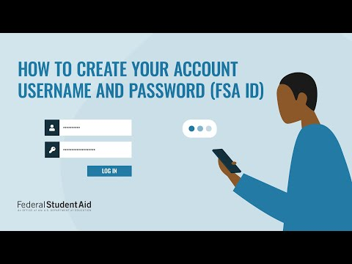
Here is a small video that demos FSA ID account creation.
Copy and paste the link below into your browser.
https://www.youtube.com/watch?v=iTb7hMVtzco&t=3s

Slide 2
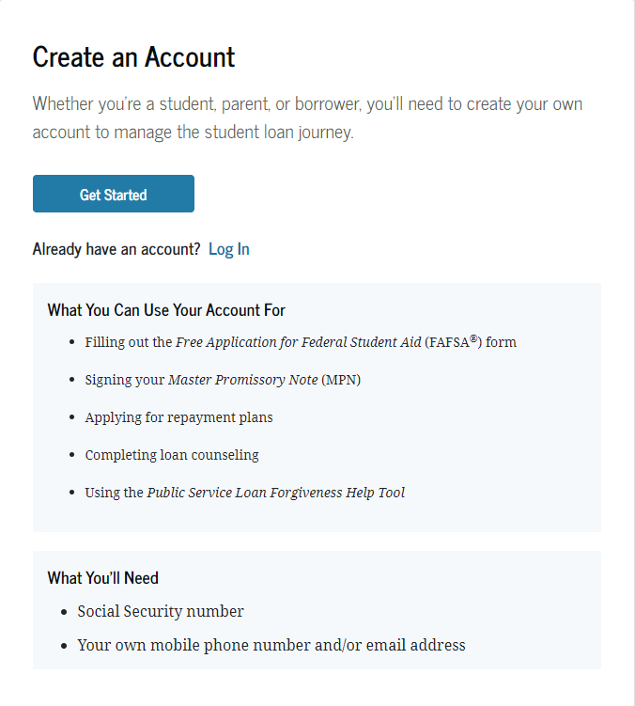
Account Creation:
https://studentaid.gov/fsa-id/create-account/launch
Various services when creating a FSA ID
You will need this to create FSA ID, but will need much more than this to complete FAFSA

Slide 3
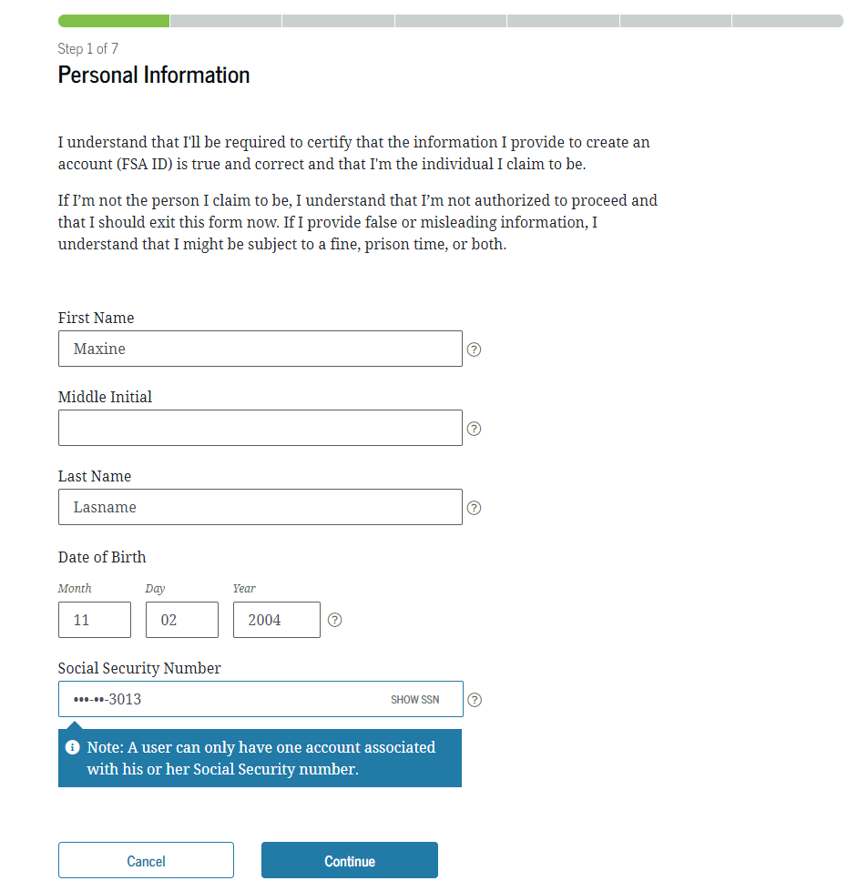
Progress bar
Carefully enter information. All information must be correct - watch for errors.
Once finished click “Continue”

Slide 4
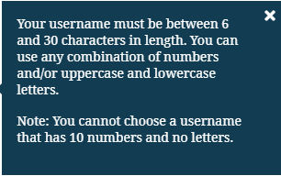
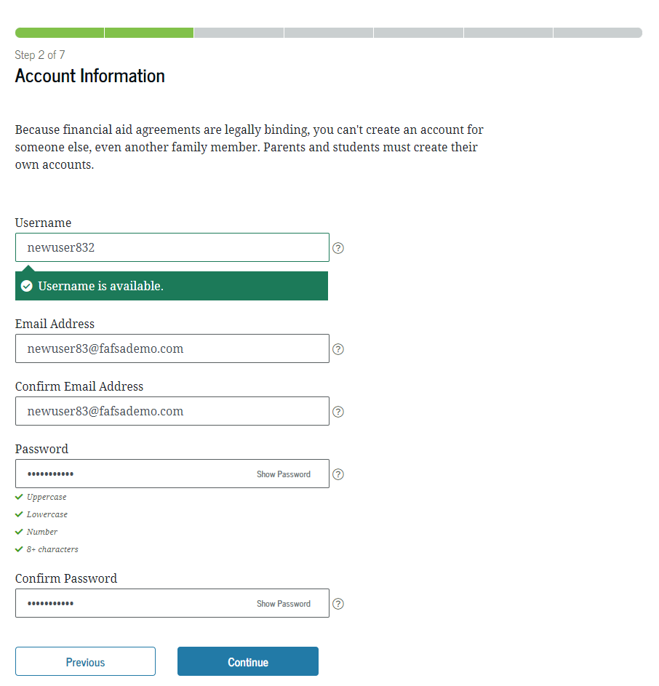
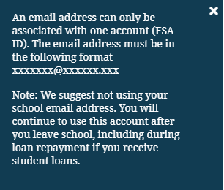
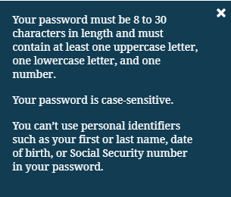
Take a picture of this page, or save the information on your phone, or write it down!
A “Username” is different than an email address.
not
Use a personal email address that is accessible.
Input a strong password; one that has numbers and unique characters
Click continue!

Slide 5
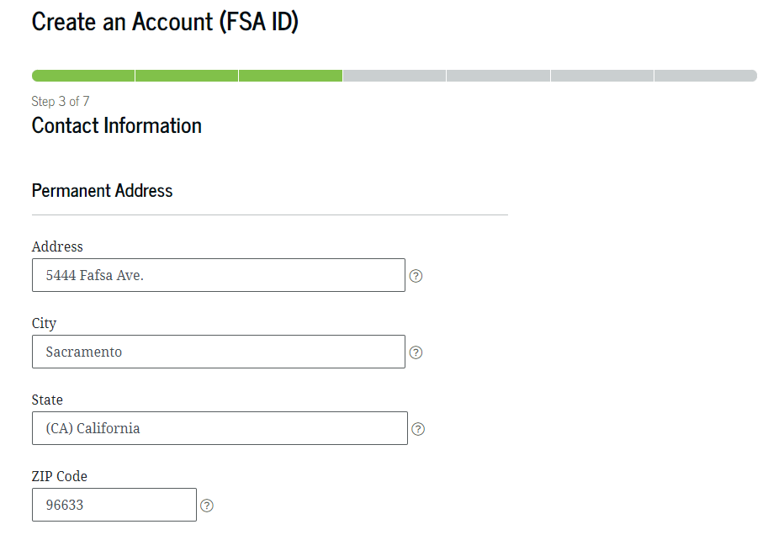
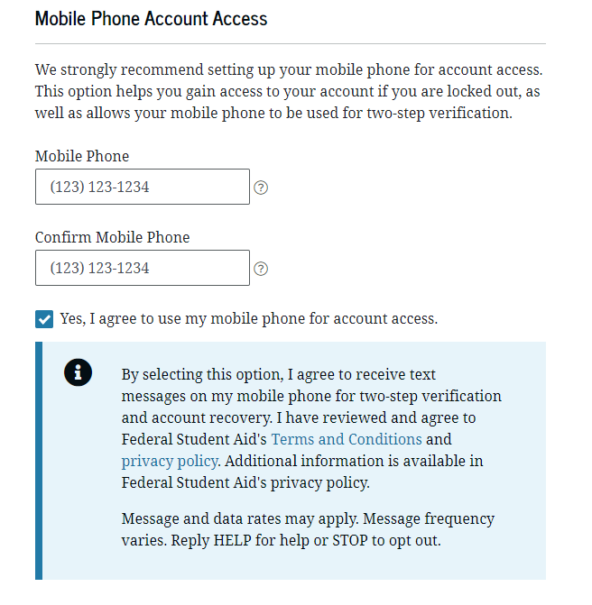
Foster Youth or Homeless students, input address where mail is accessible (i.e. friend’s house, other relative’s house)
Input all information
All FAFSA mail will go to this address
Phone information makes logging in easier
You can receive updates via SMS as well!
This is recommended, but not everyone has a phone, so it is optional.

Slide 6
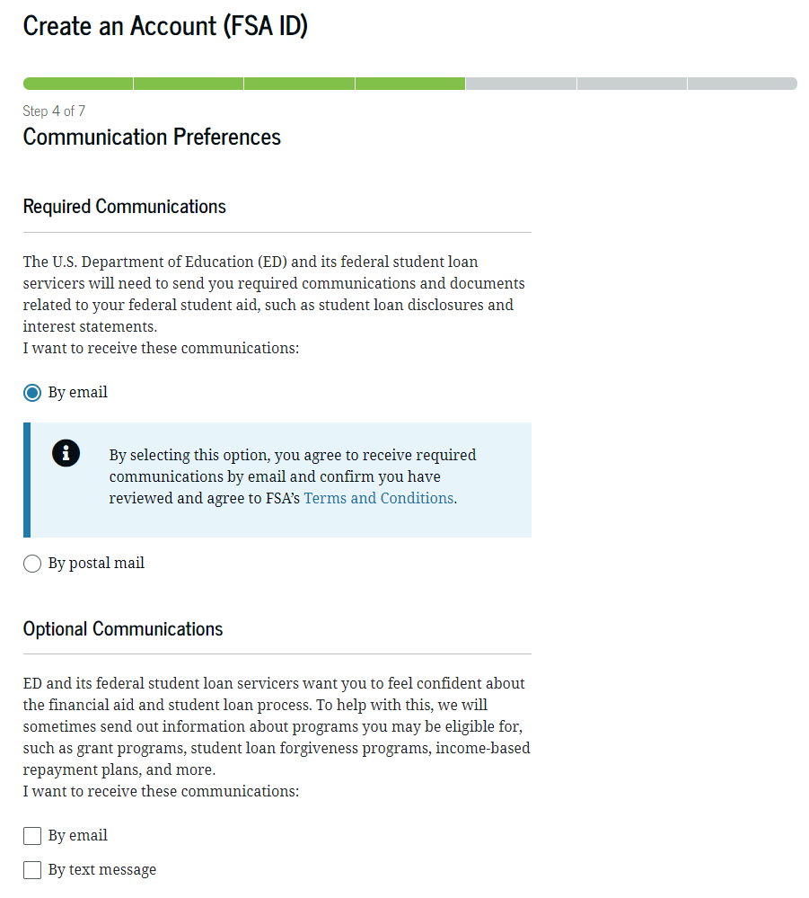
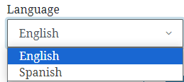
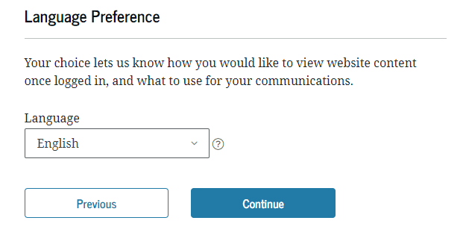
Personal preference. Get updates via email, postal mail, SMS/text.
Only Spanish and English are available.
*This will change the interface of the FSA ID into the language preference
Click “Continue”

Slide 7
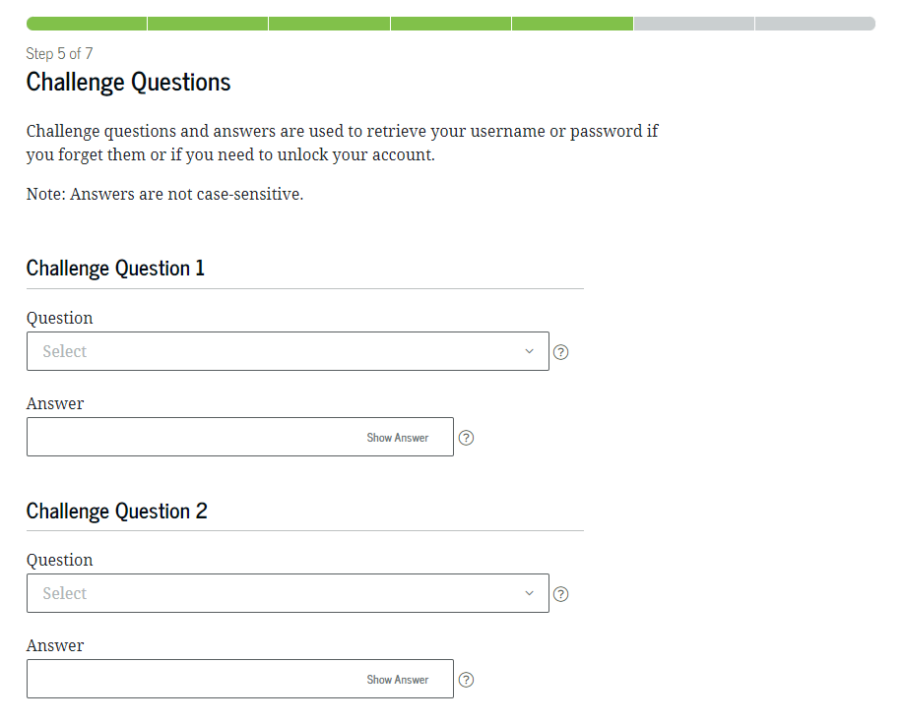
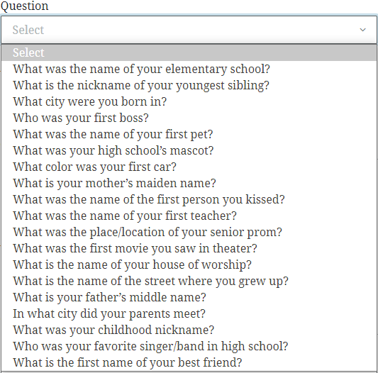
There are four challenge questions!
Choose questions that you will remember and answers you will remember most!
Take a picture, save it on your phone, or write your answers down!
Click “Continue” once you are done.

Slide 8
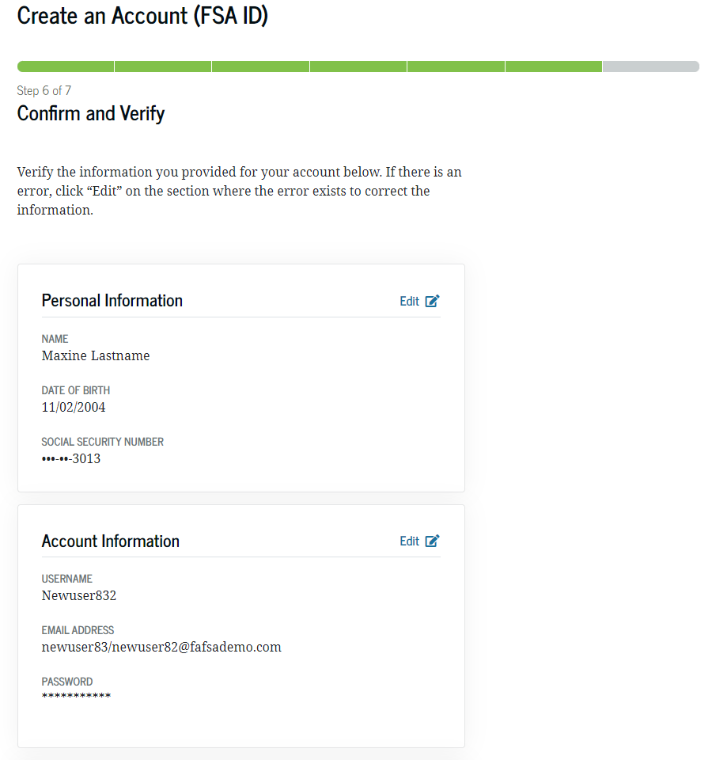
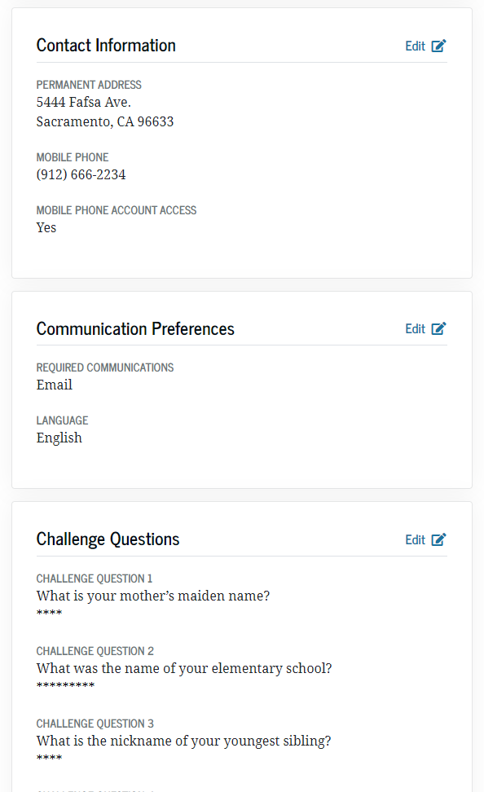
Review all the information for accuracy!
If everything looks correct, read and agree to Terms and Conditions
You are almost done! Click “continue”

Slide 9
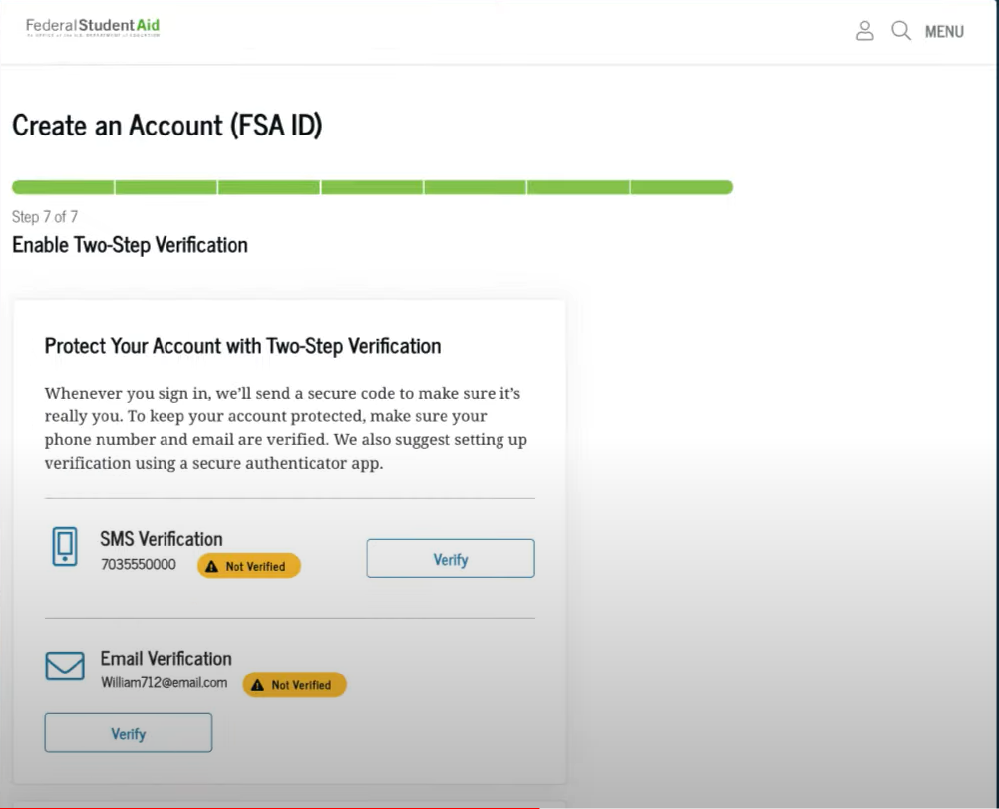
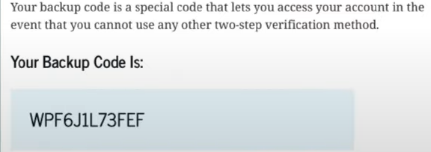
Verify SMS and verify email!
Once you verify, then you are done with FSA ID account creation and will receive a Backup Code.
It is very important to save your Backup Code!
Write this down somewhere, or save it on your phone, or take a picture.

Slide 10
You are DONE!
FAFSA & CADAA applications are delayed until December due to revisions being made!
When you apply, be sure you select the 2024-2025 application!
UPCOMING WORKSHOPS:
FAFSA/CADAA Hybrid (In-Person & Zoom) Workshop in CKM Library on 1/24/24 at 5:30pm.
FAFSA Workshop 2/7/24 during Government and Economics classes in the Auditorium. CADAA workshop in the Bilingual Room.

Slide 11
CKM Students: Complete the Google form and let us know you created your FSA ID! Copy and paste the below address into your browser.
https://docs.google.com/forms/d/e/1FAIpQLSf3dwQeauxyICFA5uYyHldTuW0BKNgcmkZsl8Da9bUaJLf6GQ/viewform

Slide 12
Forgot Username or Password

Slide 13
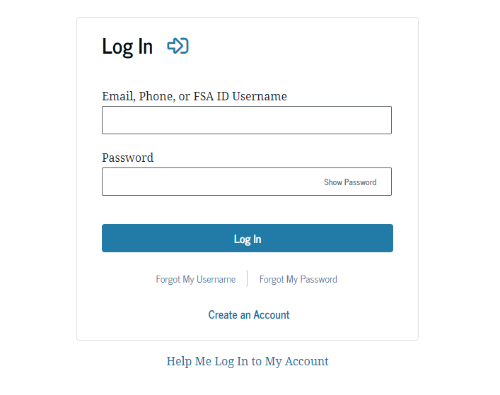
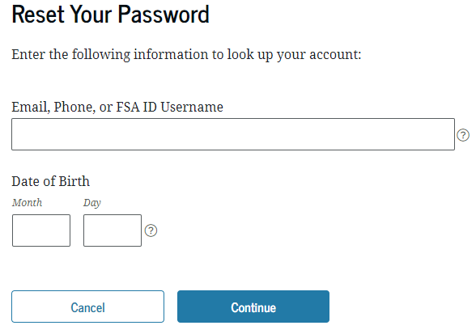
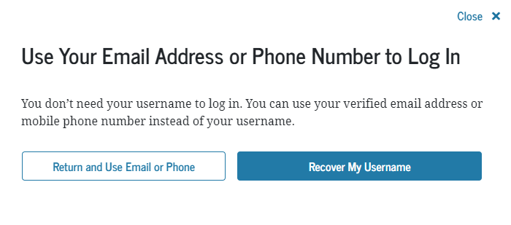
If you forgot password, you can get it back via the email used for FSA ID
Click on either of these options!
More information on logging in
If you forgot your username, you can choose these options.

